Slide 1
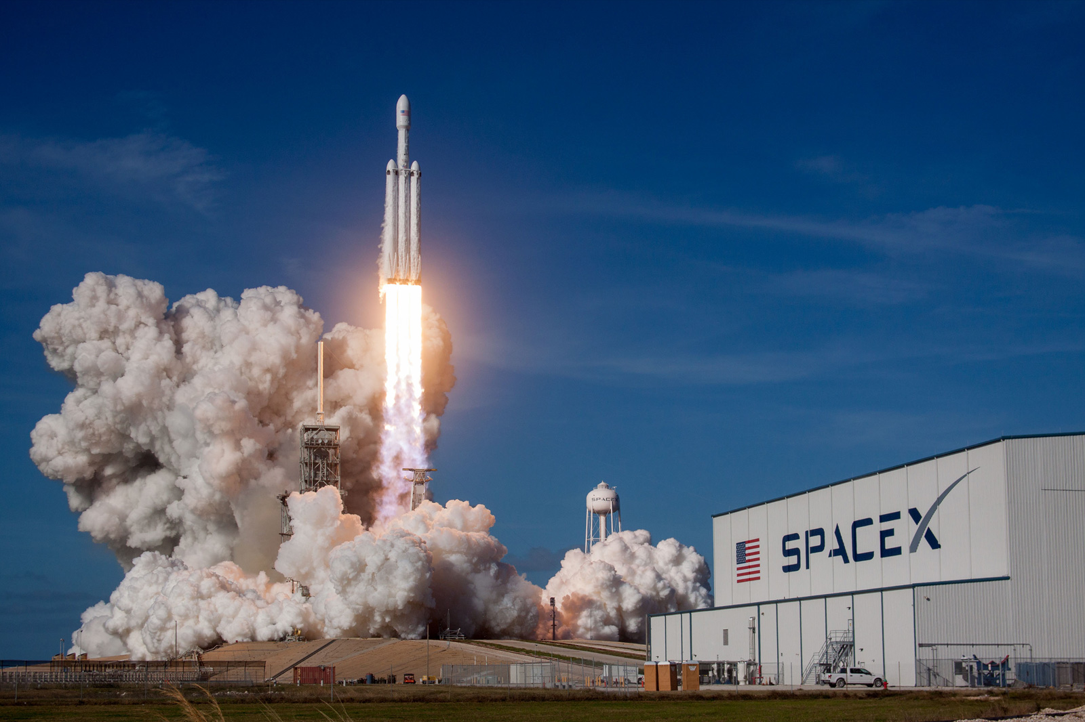
Applied Data Science Capstone
Zoltan Csiki
2024.12.27

Slide 2


OUTLINE
Executive Summary
Introduction
Methodology
Data Collection
Data Wrangling
EDA with Visualization 1-5
EDA with SQL 1-5
Interactive Map with Folium 1-3
Plotly DASH 1-3
Predective Analysis (Methodology+Steps) 1-5
Results

Slide 3
EXECUTIVE SUMMARY
I used the following methodologies:
Data collection with Web scraping and with API interface
Data wrangling with „Numpy” and „Pandas” libraries
Data analysis with SQL and with data visualization
Data visualization with „Folium” and „Dash” libraries
Predictions with machine learning libraries
Reporting of results:
Data analysis results
Interactive analysis
Predictive analysis results

Slide 4
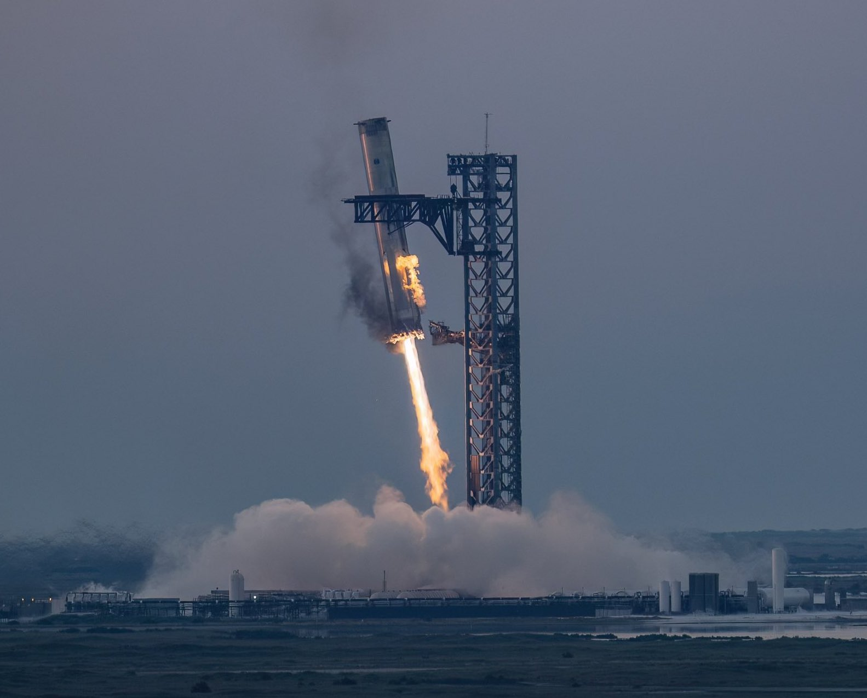
INTRODUCTION
In this section, we will review what the following research was about:
SpaceX is a very successful company. SpaceX advertises Falcon 9 rocket launches on its website with a cost of 62 million dollars; other providers cost upwards of 165 million dollars each, much of the savings is because SpaceX can reuse the first stage.
In this capstone, I play a data scientist who works at competitor SpaceY.
My job is to determine launch costs. I gather information about SpaceX. I determine whether the first stage is reusable. I train a machine learning model. The model predicts whether the stage is reusable.

Slide 5
METHODOLOGY
Data collection:
Data collection from Wikipedia through API and with web scraping with „BeautifulSoup”
Data wrangling:
Using Numpy and Pandas libraries
Exploratory Data Analysis (EDA) with visualization and SQL.
Data visualization with „Folium” and „Dash”
Predictive analysis with classification

Slide 6
DATA COLLECTION
During the data collection process, we collect data from public databases. e.g.: Wikipedia, spacexdata.com.
The data obtained from the API will be in Json format. This data is unstructured. I got structured data by using Json_Normalize function.
In the case of web scraping, I processed the tables found on HTML pages with the BeautifolSoup library. I transformed the result into a processable data frame with the Pandas library.

Slide 7
DATA WRANGLING
85 / 5 000
Fordítási találatok
Fordítási találat
After cleaning and organizing the data, the following calculations could be performed:
In the case of data processing, I organized the data into a data frame using Pandas. I searched for missing data and examined the data type.
After cleaning and organizing the data, the following calculations could be performed:
Calculate the number and occurrence of each orbit
Calculate the number and occurence of mission outcome of the orbits
Create an arrival result label in the Result column
The end result is a CSV file.

Slide 8
EDA with Visualization 1
In this section, I conducted exploratory data analysis and service design on Falcon 9 rocket launches.
The data was in CSV format and I organized it into a data frame using Pandas.
I extracted information from the organized data using the following chart types:
Scatter point chart
Bar char
Line chart
I got the following results:

Slide 9
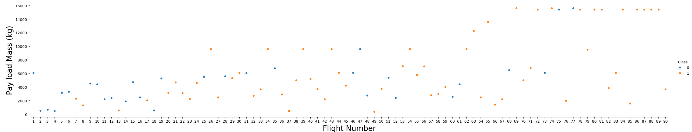
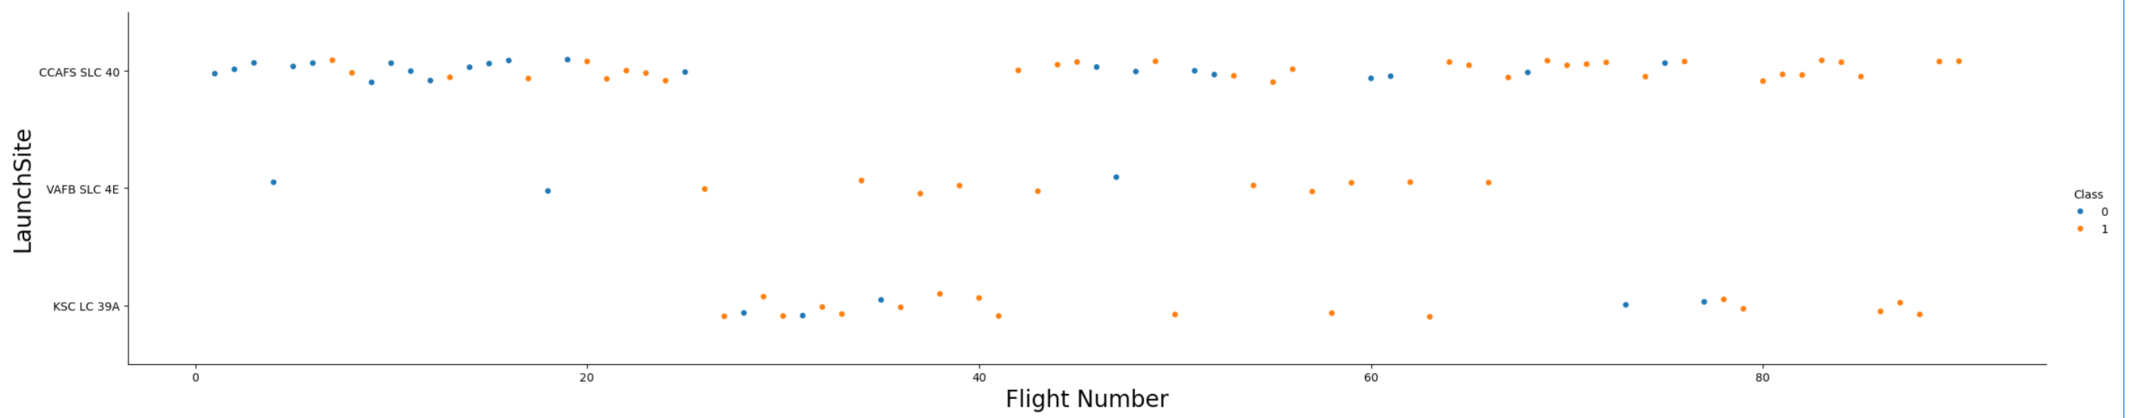
EDA with Visualization 2
I plot out the FlightNumber vs. PayloadMassand overlay the outcome of the launch:
I visualize the relationship between Flight Number and Launch Site:

Slide 10
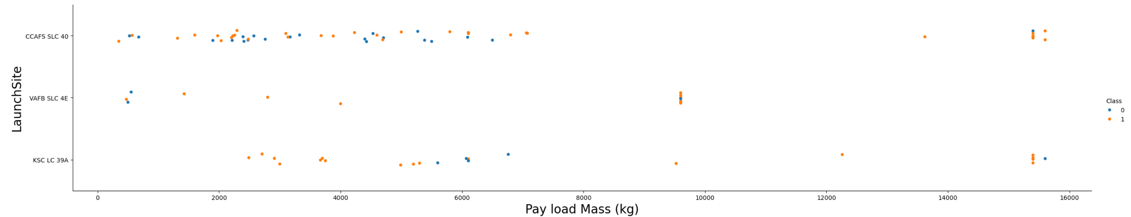
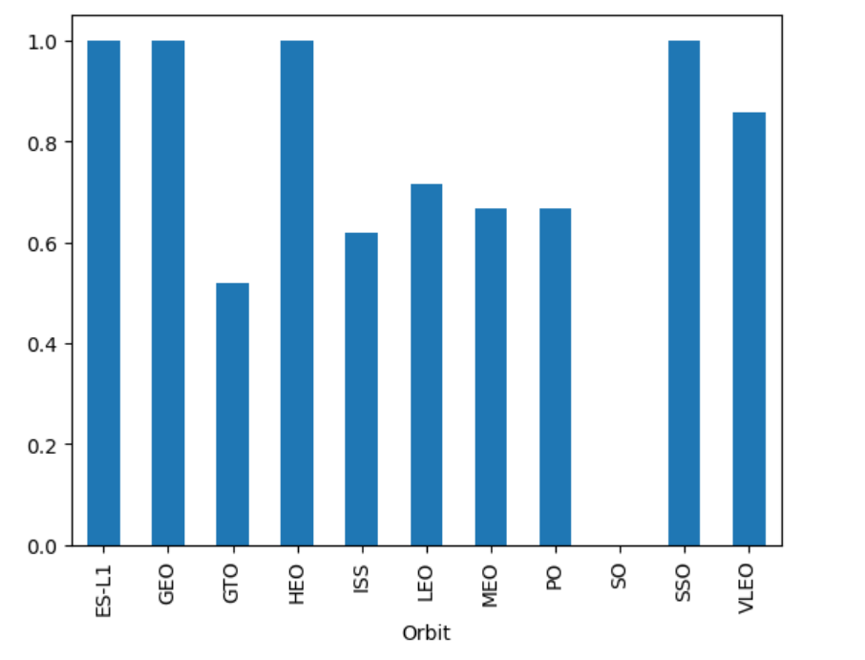
EDA with Visualization 3
I visualize the relationship between Payload Mass and Launch Site:
I visualize the relationship between success rate of each orbit type:

Slide 11
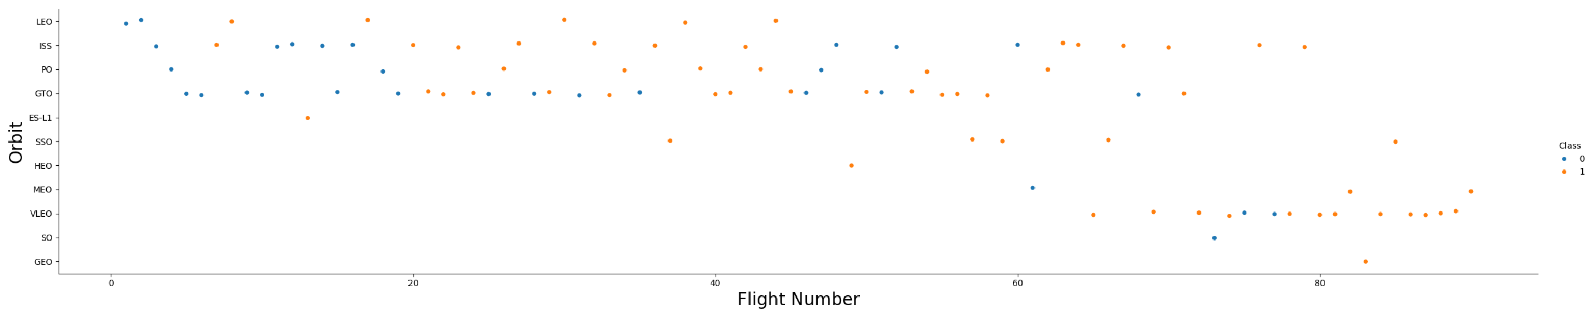
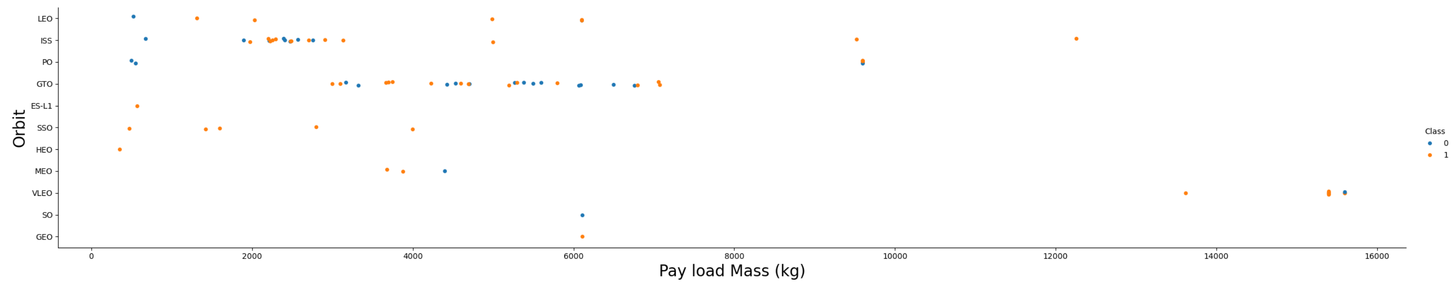
EDA with Visualization 4
I visualize the relationship between FlightNumber and Orbit type:
I visualize the relationship between Payload Mass and Orbit type:

Slide 12
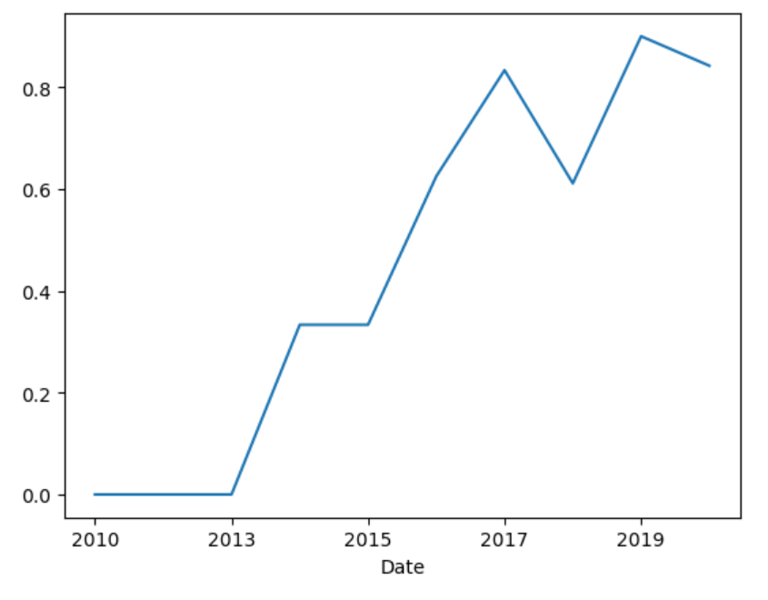
EDA with Visualization 5
I visualize the launch success yearly trend:
I saved the processed data in a csv file.

Slide 13
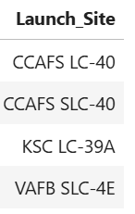
EDA with SQL 1
We can get accurate data from the database using SQL queries. I organized the CSV data into a data frame using Panadas. I got the following data from the data frame using queries:
Display the names of the unique launch sites in the space mission

Slide 14
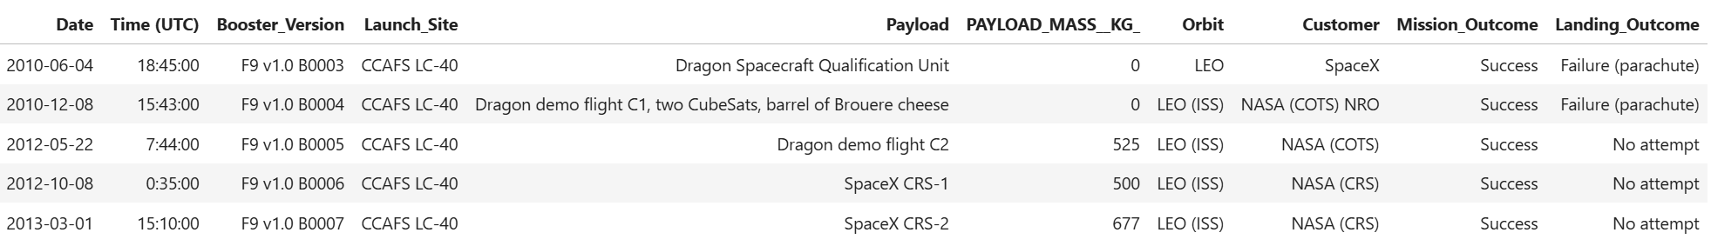
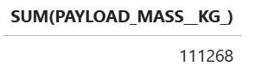
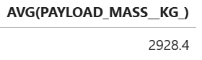
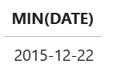
EDA with SQL 2
Display 5 records where launch sites begin with the string 'CCA’
Display the total payload mass carried by boosters launched by NASA (CRS)
Display average payload mass carried by booster version F9 v1.1
List the date when the first succesful landing outcome in ground pad was acheived.

Slide 15
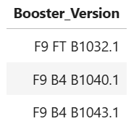
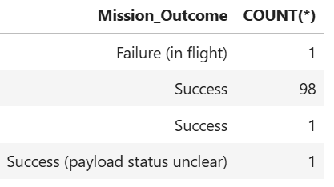
EDA with SQL 3
List the names of the boosters which have success in drone ship and have payload mass greater than 4000 but less than 6000
List the total number of successful and failure mission outcomes

Slide 16
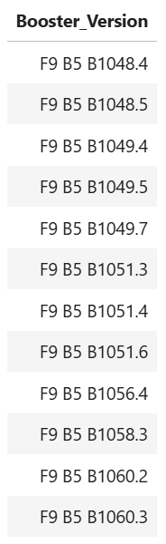
EDA with SQL 4
List the names of the booster_versions which have carried the maximum payload mass. Use a subquery

Slide 17
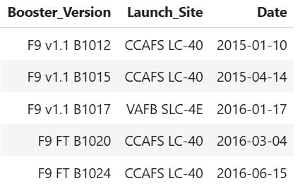
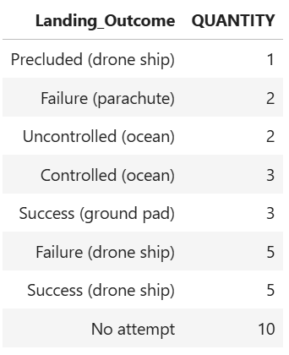
EDA with SQL 5
List the records which will display the month names, failure landing_outcomes in drone ship ,booster versions, launch_site for the months in year 2015.
Rank the count of landing outcomes (such as Failure (drone ship) or Success (ground pad)) between the date 2010-06-04 and 2017-03-20, in descending order.

Slide 18
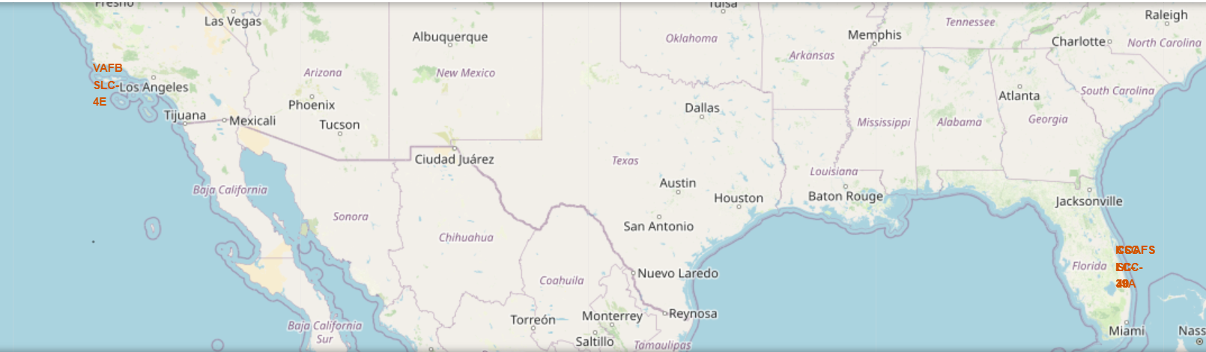
Interactive MAP with FOLIUM 1
In this section, I will perform several interactive visual analyses using Folium. Using the data, I will :
mark the launch sites on the map

Slide 19
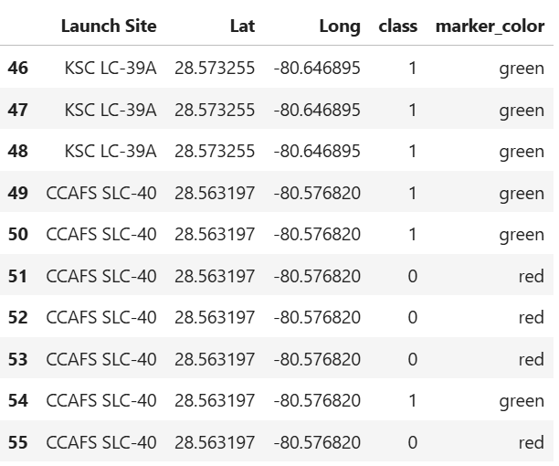
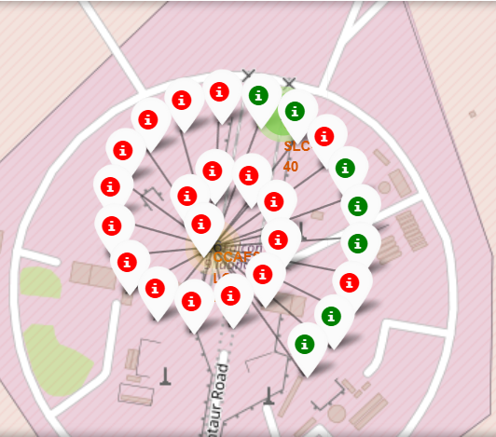
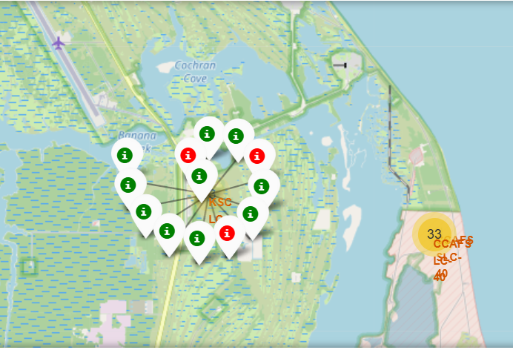
Interactive MAP with FOLIUM 2
mark the successful/unsuccessful launches of each site on the map

Slide 20
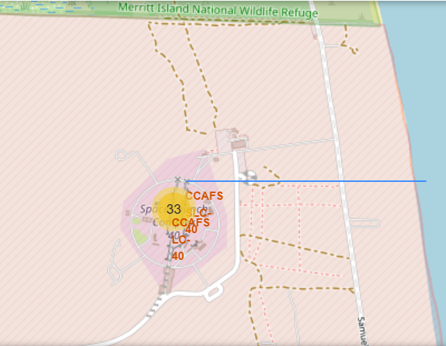
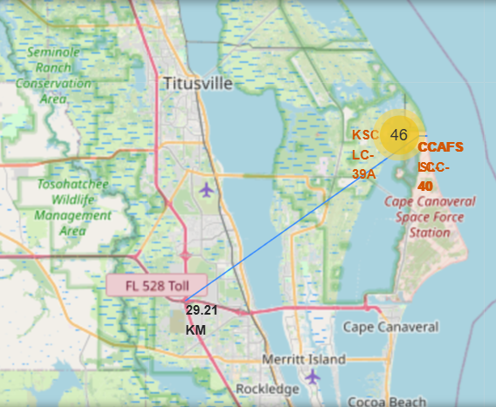
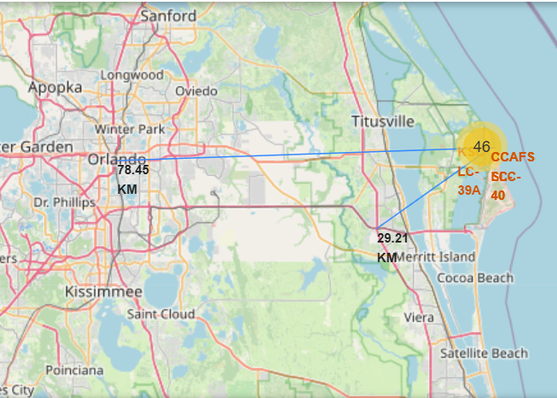
Interactive MAP with FOLIUM 3
Calculate the distances between a launch site to its proximities:

Slide 21
PLOTLY DASH 1
In this section, I will be building a Plotly Dash app that can perform interactive visual analysis on SpaceX launch data in real time.
This dashboard app includes input components such as:
a drop-down list
a range slider
a pie chart
a scatter plot.

Slide 22
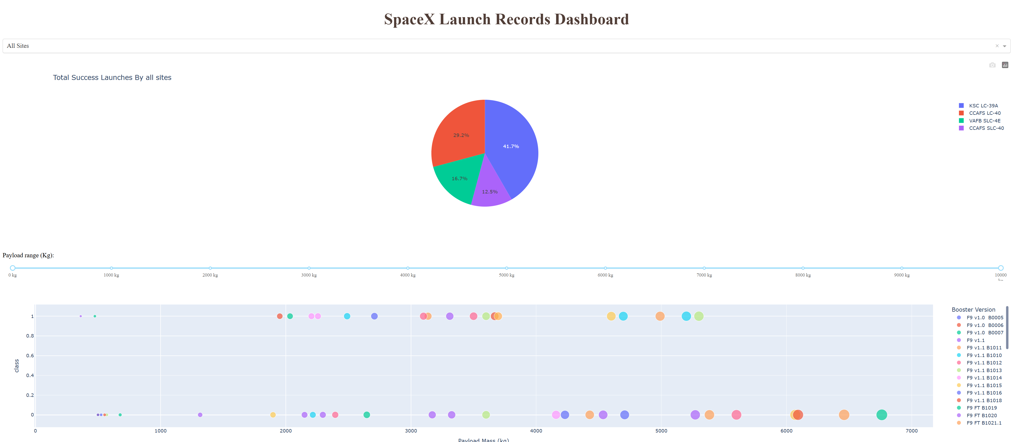
PLOTLY DASH 2
Example 1:

Slide 23
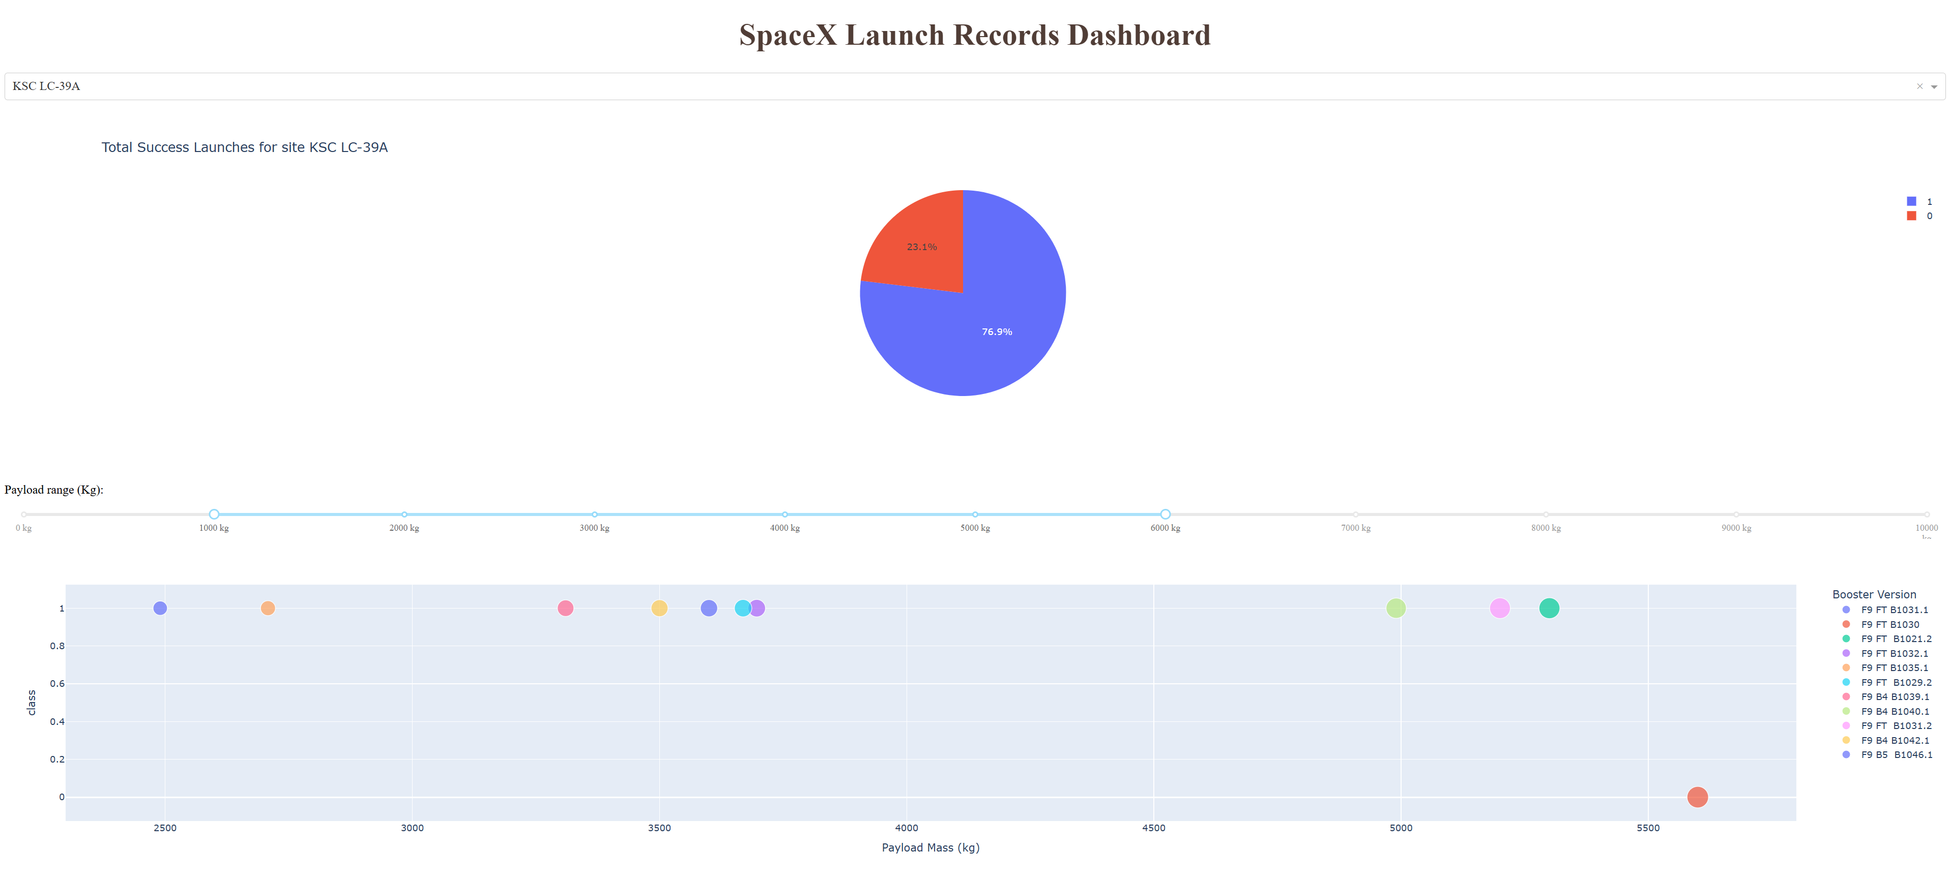
PLOTLY DASH 3
Example 2:

Slide 24
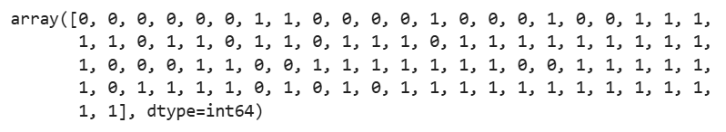
PREDICTIVE ANALYSIS 1
The methodology:
In this section, I built a machine learning pipeline to predict whether the first stage of the Falcon 9 will land successfully. This includes: preprocessing, which allows us to standardize our data, and Train_test_split, which allows us to split our data into training and testing data, train the model, and perform Grid Search execution, allowing us to find the hyperparameters that allow the best performance for a given algorithm.
Steps:
Load the dataframe from dataset_part_2.csv file.
Create a NumPy array:

Slide 25
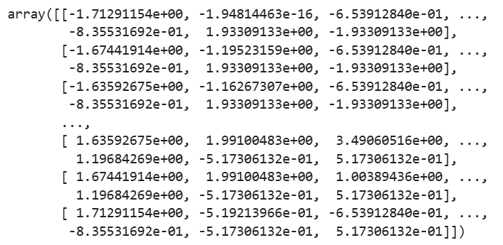
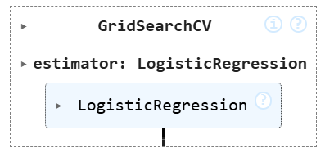
PREDICTIVE ANALYSIS 2
Standardize the data:
Use the function train_test_split to split the data X and Y into training and test data:
Create a logistic regression object / display the best parameters:

Slide 26
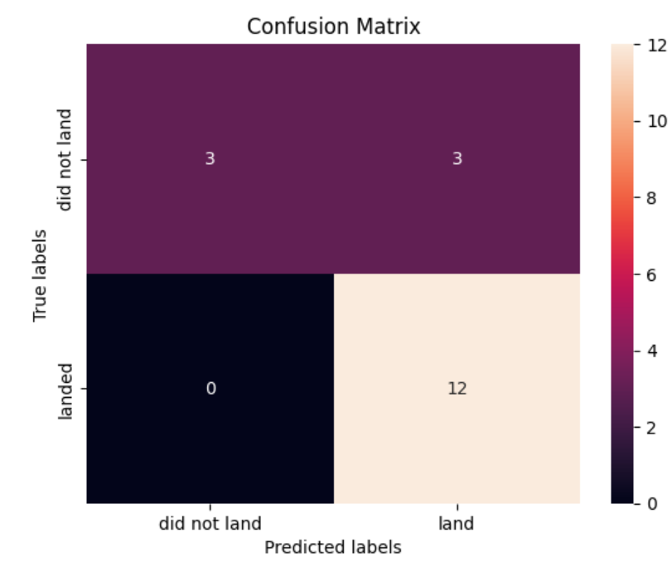
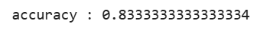
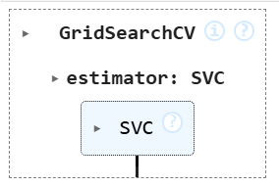
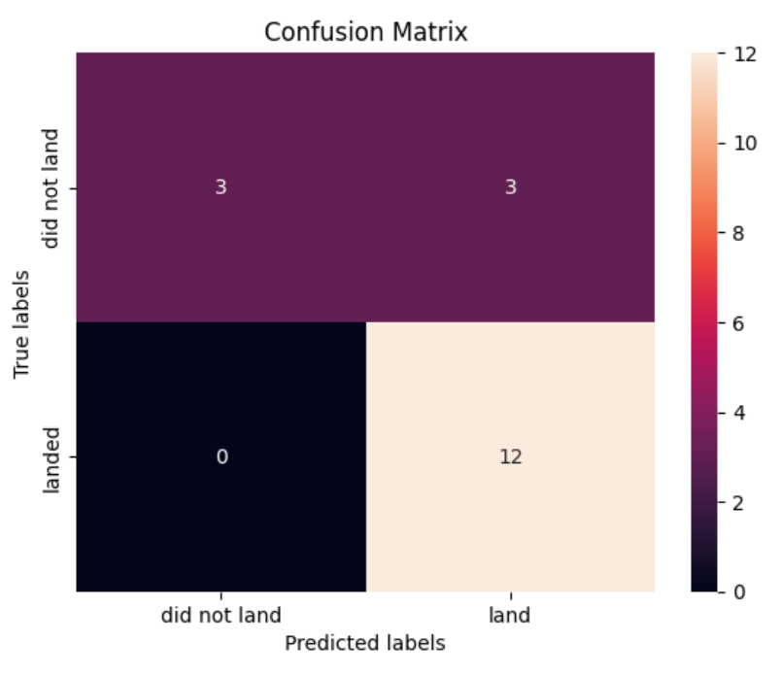
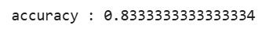
PREDICTIVE ANALYSIS 3
Calculate the accuracy / look at the confusion matrix:
Create a support vector machine / the best parameters from the dictionary:
Calculate the accuracy on the test data / plot the confusion matrix:

Slide 27
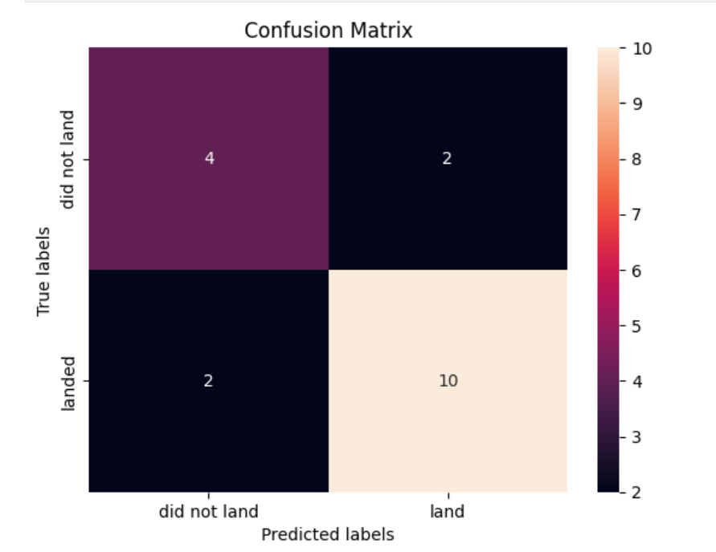
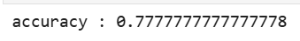
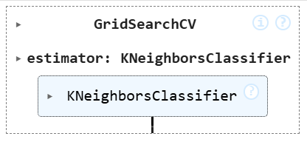
PREDICTIVE ANALYSIS 4
Create a decision tree / find the best parameters from the dictionary:
Calculate the accuracy of tree_cv:
Create a k nearest neighbors object / find the best parameters from the dictionary:

Slide 28
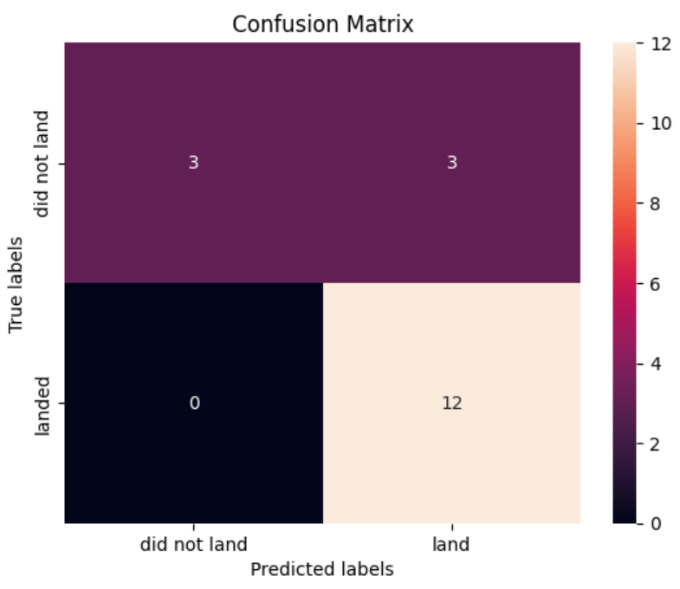
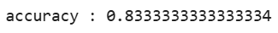
PREDICTIVE ANALYSIS 5
Calculate the accuracy of knn_cv / plot the confusion matrix:
Find the method performs best:

Slide 29
RESULTS
I got results with the following analyses:
EDA SQL queries.
Plotly Dash dashboards
Comparison of predictive analytics.

